Slide 1
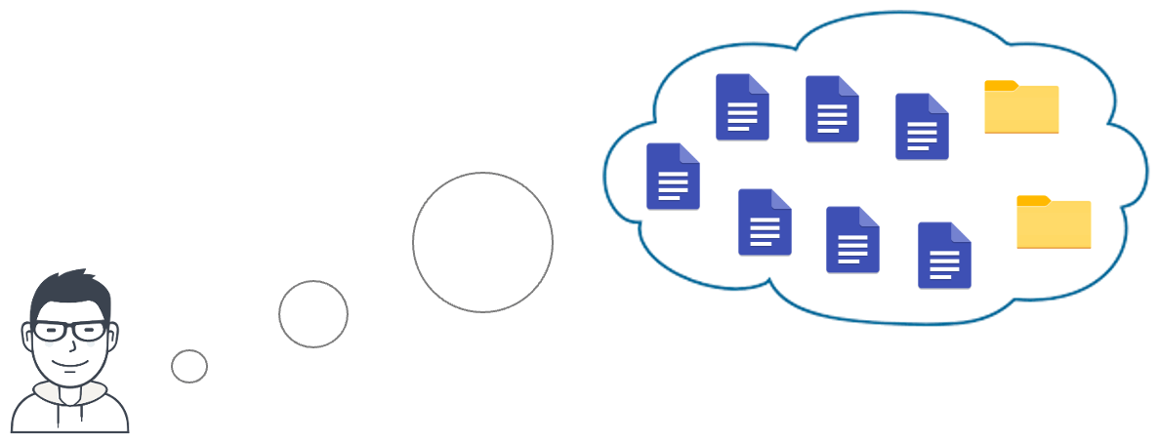
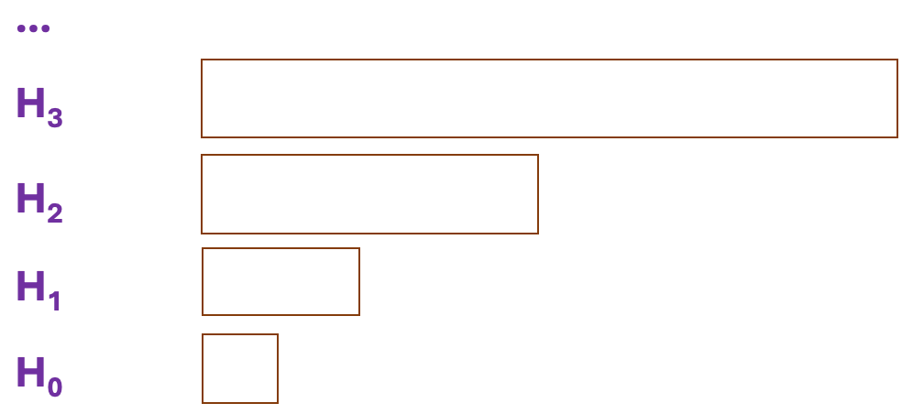
1. OVERVIEW
2. PROOF OF RETRIEVABILITY
3. FEATURES
6. EXPERIMENTS
Error-Correcting Code.
FFT-based code.
Incrementally constructible.
Server: Amazon EC2 c6i.8xlarge, 16-core Intel Xeon Platinum 8375C CPU @ 2.9 GHz and 64 GB RAM.
Client: Intel i7-6820HQ CPU @ 2.7 GHz, 16 GB RAM.
Implementation: C++ with ~4,000 LoCs.
Proof of Retrievability (PoR) allows a server to prove the possession of all data (audit) in an efficient manner.
Dynamic PoR (DPoR) schemes additionally support efficient update capability.
Homomorphic MAC. The authentication tags can be aggregated into a single tag according to some linear combination.
$87×−14,012×$ smaller proof size than previous DPoR schemes.
Storage-as-a service (STaaS)
Scheme | Proof Size (KB)
Porla_{ipa} | 0.64 - 1.03
Porla_{kzg} | 0.31
We proposed and designed Porla:
Verifiable Computation Techniques.
KZG (AsiaCrypt’ 10).
Inner Product Argument in Bulletproofs (IEEE S&P’ 18).
Data loss can happen due to:
Hardware failures.
Adversarial behaviors.
Previous DPoRs | Our Work (Porla)
Low storage (USENIX’ 21) Fast update (CCS’ 13) Metadata privacy (JoC’ 17) | Small Proof Size Low Audit Time
Independent with database size
$4×−18,000×$ faster audit time than prior approaches.
Support Public Audit.
Block Size | Porla_{ipa} (ms) | Porla_{kzg} (ms)
4 KB | 51.52 - 68.04 | 37.77 - 48.66
32 KB | 84.42 - 137.44 | 57.26 - 114.98
256 KB | 310.61 - 843.84 | 105.85 - 478.68
4. ERROR-CORRECTING CODE
5. PROOF OF POLYNOMIAL EVALUATION
Secret key: $α$
Data block: $\overset{⃑}{v}=(v_{1}, v_{2}, …, v_{n})$
Commitment of $\overset{⃑}{v}$:
$$cm ≔{\vec{g}}^{\vec{v}}$$
MAC of Commitment:
$$σ ≔ {({\vec{g}}^{\vec{v}})}^{α}h^{r}$$
$$\vec{g}∈𝔾^{n}$$
$1.2×−3×$slower update than the counterpart
using the same ECC (Shi, CCS’ 13).
$${\text{PRF}}_{k}(time, level, index)$$
Block Size | Porla_{ipa} (ms) | Porla_{kzg} (ms)
4 KB | 35.66 - 42.21 | 36.75 - 43.99
32 KB | 62.91 - 87.52 | 51.23 - 72.98
256 KB | 164.04 - 280.87 | 100.05 - 186.63
Codeword
MAC
Temporary Codeword
ICC operations are based on FFT butterfly circuit.
Our data structure includes:
7. CONCLUSION
Q&A
Raw buffer U:
…
Bulletproofs (IEEE S&P’ 18) | KZG (AsiaCrypt’ 10)
Not require trusted setup. $\left|π\right|=𝒪(\log{D)}$ | Required trusted setup. $\left|π\right|=𝒪(1)$
Our Porla:
Small audit cost: proof size and end-to-end latency.
Maintain a reasonable data update performance.
Our source code is published at:
github.com/vt-asaplab/porla
Erasure code C:
…
Hierarchical Log H:
…
Data block
Previous DPORs | Our Porla
Low storage (USENIX’ 21) Fast update (CCS’ 13) Metadata privacy (JoC’ 17) | Small Proof Size Low Audit Time
H₃
For any questions:
tungle@vt.edu
H₂
Codeword
H₁
Homomorphic MAC
H₀
EFFICIENT DYNAMIC PROOF OF RETRIEVABILITY FOR COLD STORAGE*
Tung Le†, Pengzhi Huang‡, Attila A. Yavuz¶, Elaine Shi§, Thang Hoang†
†: Virginia Tech ‡: Cornell University ¶: University of South Florida §: Carnegie Mellon University
eprint.iacr.org/2022/1417
*Full Paper
*: This paper has been accepted and published to The Network and Distributed System Security Symposium (NDSS) 2023

